Slide 1
P. Sci.
Chapter 11
Motion

Slide 2
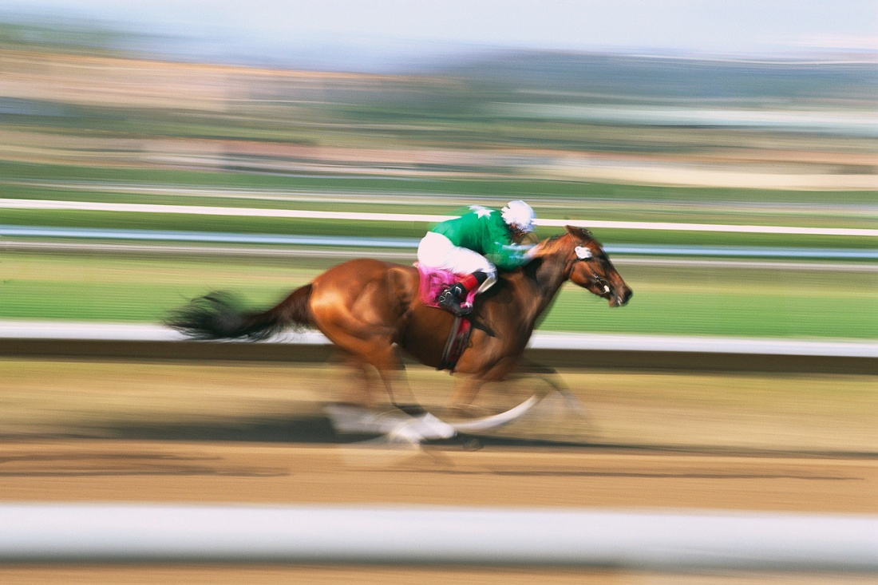
Motion
when something changes position

Slide 3
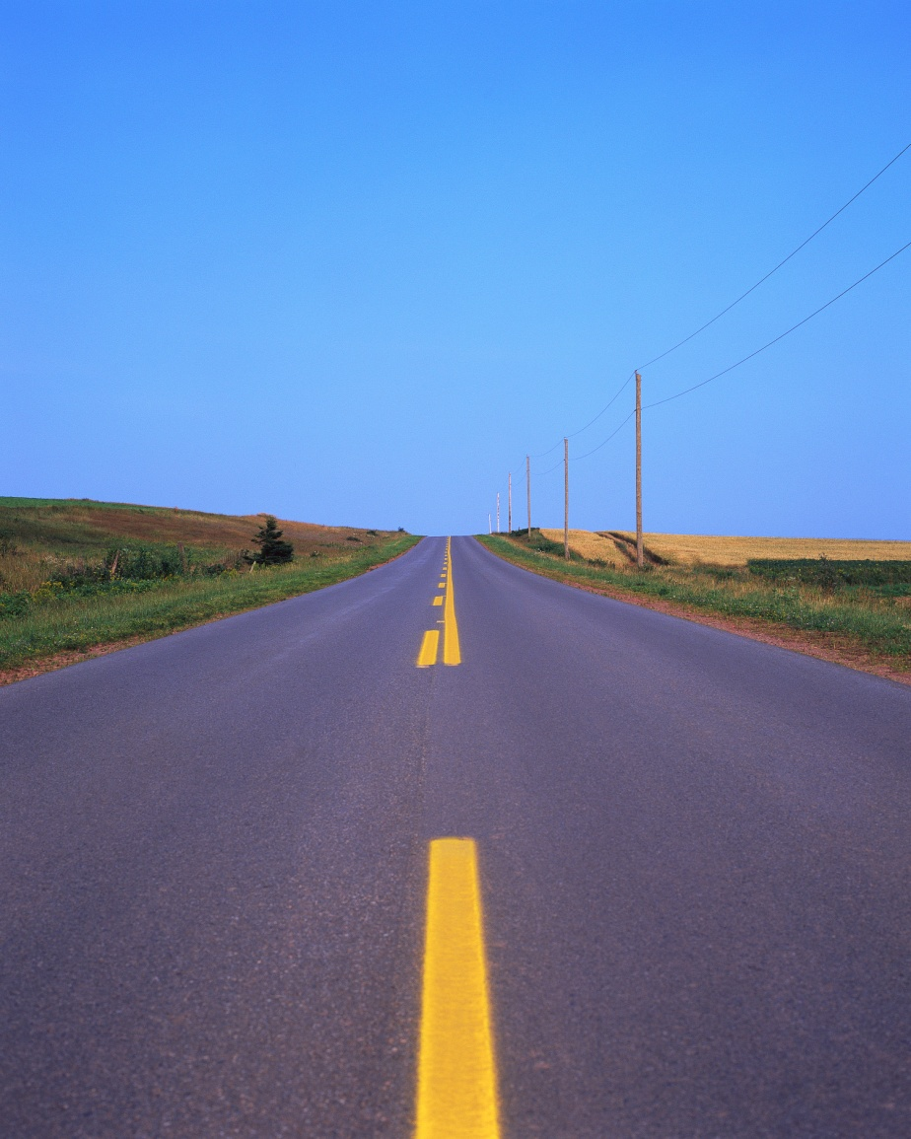
Distance
How far the object travels

Slide 4
Displacement
the distance an object has been moved from one position to another

Slide 5
Example
one car travels from one town to another that is 20 km to the east.
X→→→→→→→→→→→→→→→→→ X
20 km

Slide 6
another car travels around a track for 20 km and ends up at the starting point.
X

Slide 7
Both cars traveled a distance of 20 km but the first car’s displacement is 20 km east while the second car’s displacement is 0 km because it ended up where it started from.

Slide 8
Frame of reference
To describe motion accurately and completely, a frame of reference is necessary.
Frame of reference is a system of objects that are not moving with respect to one another.

Slide 9
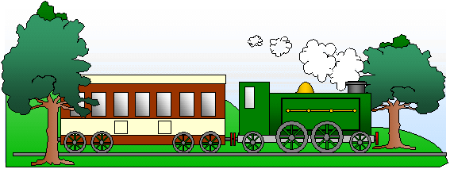
If you are standing beside the tree on the left what is moving?
If you are on the train what is moving?
If you are riding down the road on a buss is your friend moving beside you?
Are the road signs moving?

Slide 10
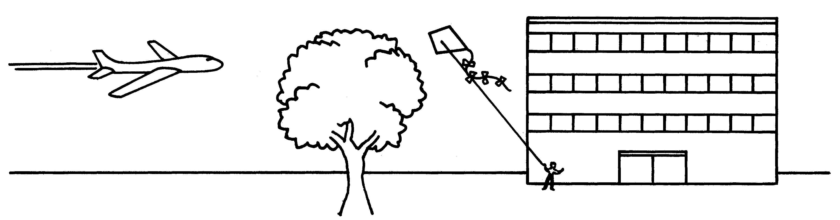
If you are on the plane what is moving from your frame of reference?
If you are beside the tree what is moving from your frame of reference?

Slide 11
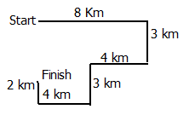
Displacement vs. Distance
Distance is the total length traveled
Displacement is the distance measured directly from starting to stopping point.
  What is the distance traveled on the path below?
  What is the displacement?

Slide 12
A runner leaves his house and runs two blocks east, then three blocks south and finally 1 block west.
  How far has the runner traveled?
  What is his displacement?
What is the distance traveled of a race car driver in the Indy 500?
What is the displacement of a race car driver in the Indy 500?

Slide 13
Speed
How much time it takes for a change in position to occur or how fast something moves.

Slide 14
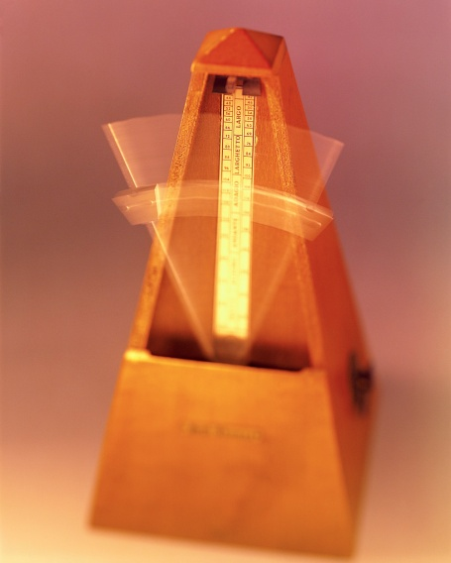
Any change over time is called a rate.
Speed is the rate of change in position or the rate of motion.

Slide 15
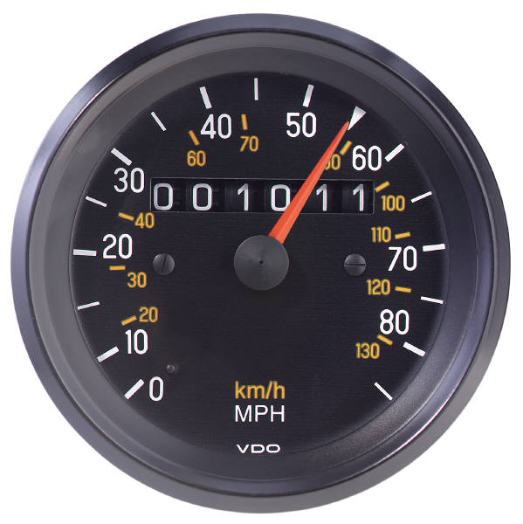
Kinds of Speed
1. Instantaneous Speed – the rate of motion at any given instant. (speedometer)

Slide 16
2. Constant Speed – a speed that does not vary. (cruise control)

Slide 17
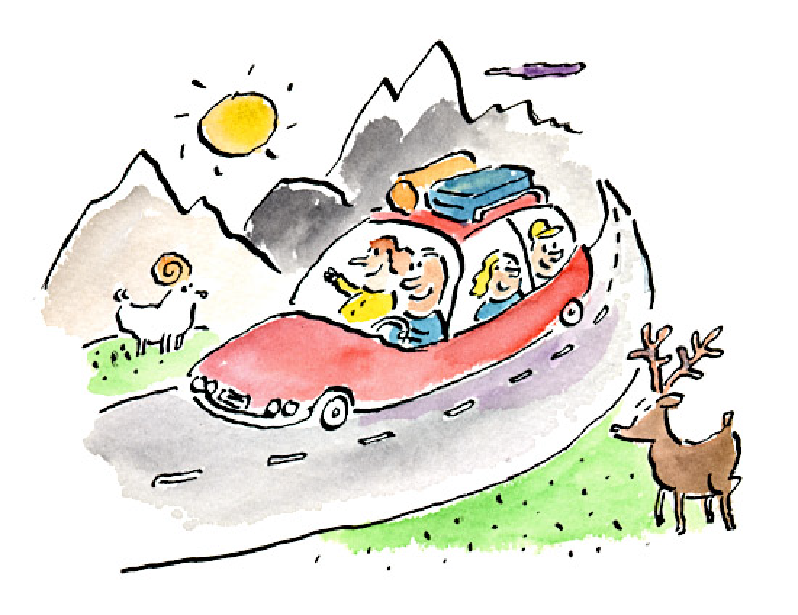
3. Average Speed – is the total distance traveled by total time of travel. (miles per hour)

Slide 18
Formula for speed:
d
s = t

Slide 19
Velocity
is both speed and direction
Like speed, velocity may change
Unlike speed, the velocity can change while the speed stays constant (Because velocity includes both speed and direction, if either value changes, velocity will change )

Slide 20
Formula for velocity:
d (in a certain direction)
v = t

Slide 21
Terminal velocity
the highest velocity that will be reached by a falling object.

Slide 22
Magic Triangle with units
Distance
(meters)
Time
(seconds)
Speed
(m/s)

Slide 23
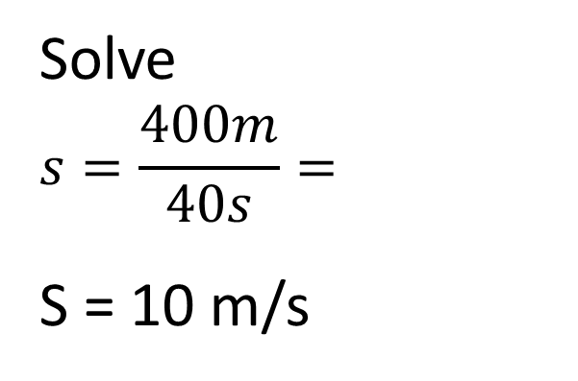
Velocity and speed
Both are calculated by dividing distance by time.
    Velocity = distance/time speed= distance/time
    Velocity had a direction, speed does not.
  UNITS of speed and velocity is meter/second or kilometer/hour
1. A runner ran 400 meters for 40 seconds. At what speed did he run?
Given:
400 m = distance
40 s = time
?? = speed
Solve
$$s=\frac{400m}{40s}=$$
S = 10 m/s
d
s
t

Slide 24
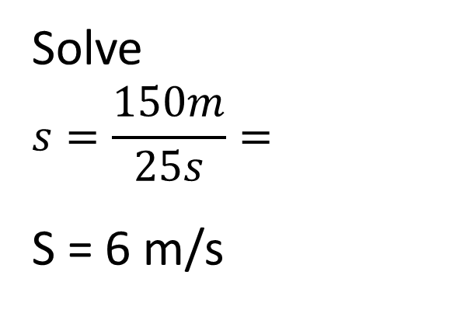
Velocity and speed
2. What is the speed of a bobsled whose distance-time graph indicates that it traveled 150 m in 25 s?
Given:
150 m = distance
25 s = time
?? = speed
Solve
$$s=\frac{150m}{25s}=$$
S = 6 m/s
d
s
t

Slide 25
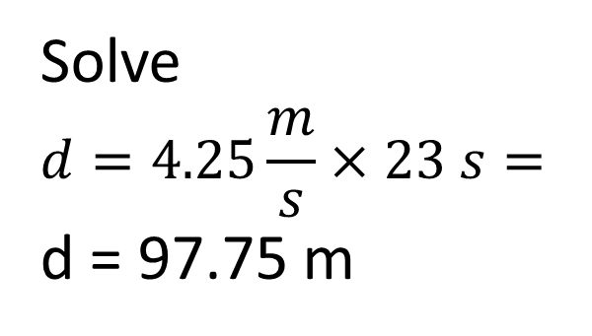
Velocity and Speed
3. A runner traveling at 4.25 m/s will travel how far in 23 s?
Given:
4.25m/s = speed
23 s = time
?? = distance
Solve
$$d=4.25\frac{m}{s}×23 s=$$
d = 97.75 m
d
s
t

Slide 26
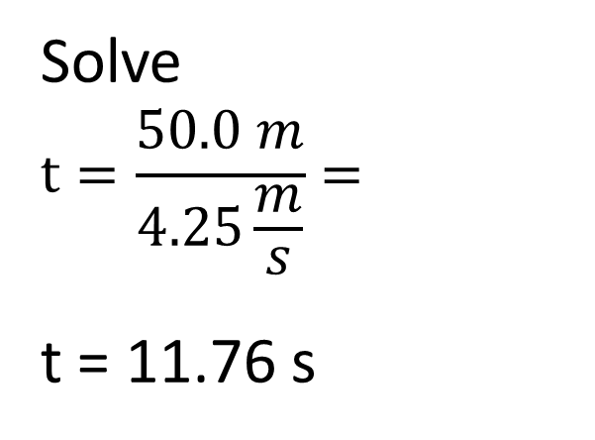
Velocity and Speed
4. How long will it take a runner going 4.25 m/s to travel 50.0 meters?
Given:
4.25 m/s = speed
50.0 = meters
?? = time
Solve
$$t=\frac{50.0 m}{4.25\frac{m}{s}}=$$
t = 11.76 s
d
s
t

Slide 27
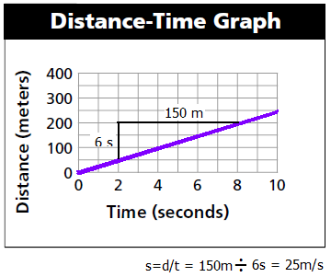
Graphing Speed
A distance-time graph is a good way to describe motion
The slope of a line on a distance-time graphs is speed

Slide 28
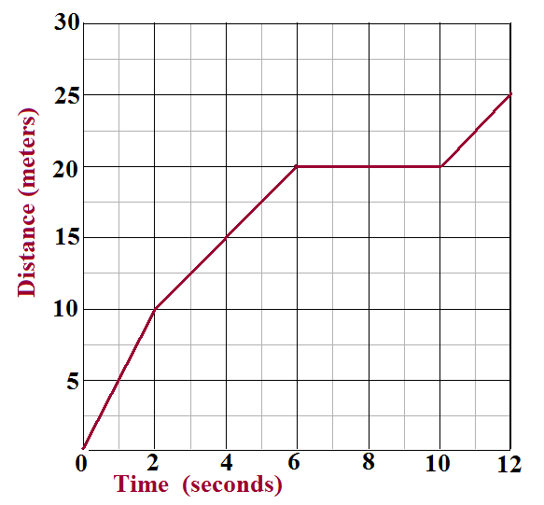
What is the objects average speed?
What is it’s speed between 6s and 10 s?
When is it traveling the fastest?
When is it NOT moving?

Slide 29
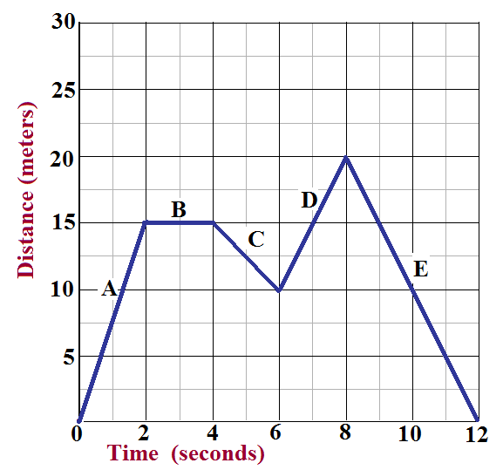
Where is the object standing still?
Where is the object traveling backwards?
Where is the object traveling at 5m/s?
What is speed at line E?

Slide 30

Acceleration

Slide 31
Acceleration
the rate of change of velocity.
Acceleration is both the rate of change in velocity and the direction of that change.
So, even if an objects’ speed remains constant acceleration occurs if the direction changes.

Slide 32
Acceleration (cont.)
IF:
an object travels in a straight line acceleration is just the rate of change of speed.
the acceleration is in the same direction as the velocity (change of direction) then the object speeds up.
the acceleration is in the opposite direction from velocity then the object slows down.

Slide 33
To calculate average acceleration, divide the change in velocity by the time interval.
vf - vi ∆ v
a = t = t
Where: a = average acceleration
vf = final velocity
vi = initial (starting) velocity
t = time
∆ = a greek symbol for delta (change) and it stands for “change in”
∆ v = change in velocity
v_{f} - v_{i}
a
t

Slide 34
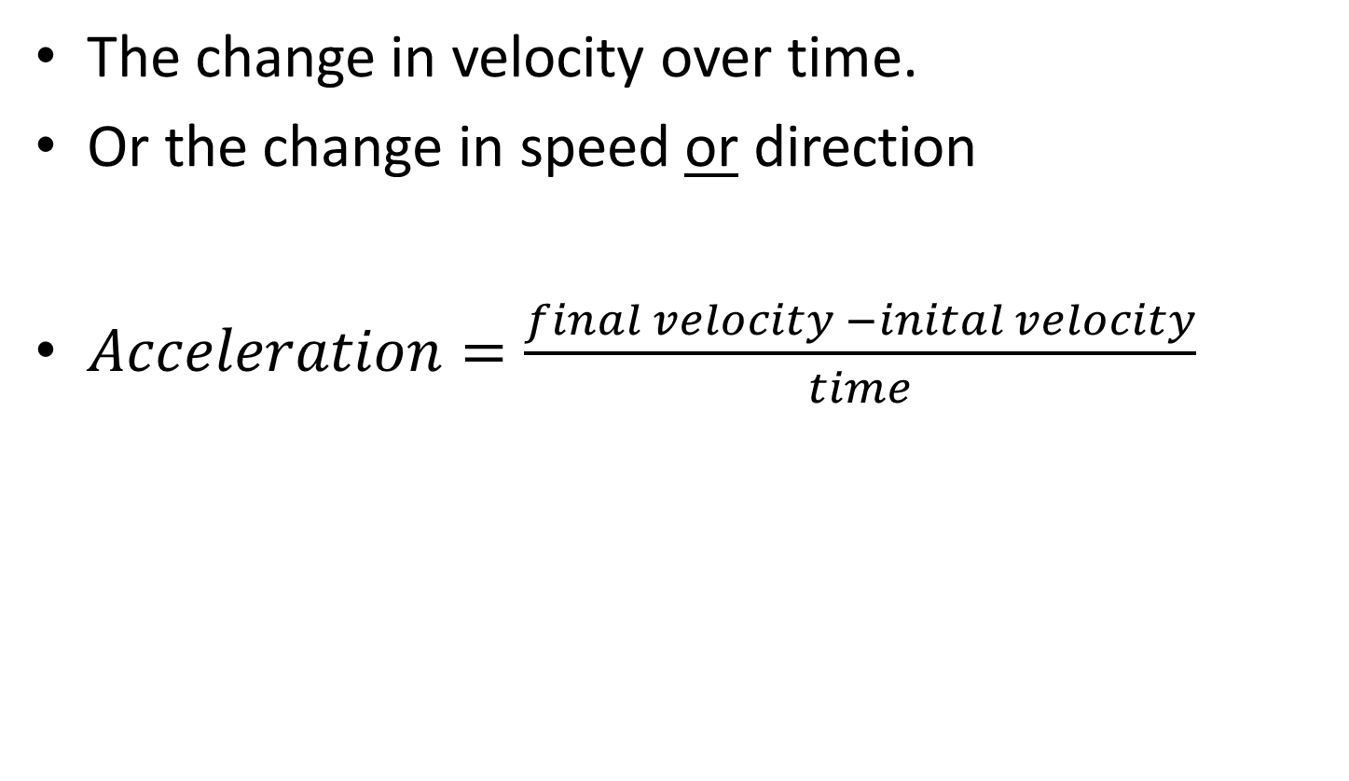
Acceleration
The change in velocity over time.
Or the change in speed or direction
$Acceleration=\frac{final velocity −inital velocity}{time}$

Slide 35
Acceleration cont.
If acceleration is small – speed change is gradual
If acceleration is large – speed change is rapid.

Slide 36
Acceleration cont.
Positive acceleration = object is speeding up
Negative acceleration =
object is slowing down

Slide 37
D. Calculations
Your neighbor skates at a speed of 4 m/s. You can skate 100 m in 20 s. Who skates faster?
GIVEN:
d = 100 m
t = 20 s
v = ?
WORK:
v = d ÷ t
v = (100 m) ÷ (20 s)
v = 5 m/s
You skate faster!
d
v
t

Slide 38
D. Calculations
A roller coaster starts down a hill at 10 m/s. Three seconds later, its speed is 32 m/s. What is the roller coaster’s acceleration?
GIVEN:
v_{i} = 10 m/s
t = 3 s
v_{f} = 32 m/s
a = ?
WORK:
a = (v_{f} - v_{i}) ÷ t
a = (32m/s - 10m/s) ÷ (3s)
a = 22 m/s ÷ 3 s
a = 7.3 m/s²
v_{f} - v_{i}
a
t

Slide 39
D. Calculations
Sound travels 330 m/s. If a lightning bolt strikes the ground 1 km away from you, how long will it take for you to hear it?
GIVEN:
v = 330 m/s
d = 1km = 1000m
t = ?
WORK:
t = d ÷ v
t = (1000 m) ÷ (330 m/s)
t = 3.03 s
d
v
t

Slide 40
D. Calculations
How long will it take a car traveling 30 m/s to come to a stop if its acceleration is -3 m/s²?
GIVEN:
t = ?
v_{i} = 30 m/s
v_{f} = 0 m/s
a = -3 m/s²
WORK:
t = (v_{f} - v_{i}) ÷ a
t = (0m/s-30m/s)÷(-3m/s²)
t = -30 m/s ÷ -3m/s²
t = 10 s
v_{f} - v_{i}
a
t

Slide 41
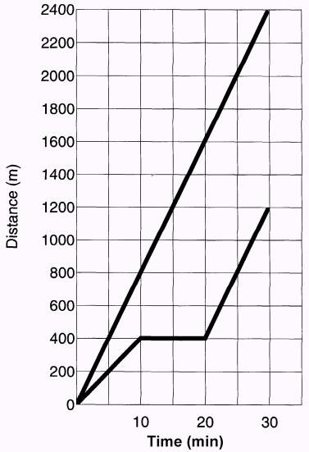
E. Graphing Motion
Distance-Time Graph
slope =
steeper slope =
straight line =
flat line =
speed
A
faster speed
B
constant speed
no motion

Slide 42
E. Graphing Motion
Distance-Time Graph
Who started out faster?
  A (steeper slope)
Who had a constant speed?
  A
Describe B from 10-20 min.
  B stopped moving
Find their average speeds.
  A = (2400m) ÷ (30min) A = 80 m/min
  B = (1200m) ÷ (30min) B = 40 m/min
A
B

Slide 43
E. Graphing Motion
Distance-Time Graph
Acceleration is indicated by a curve on a Distance-Time graph.
Changing slope = changing velocity

Slide 44
E. Graphing Motion
Speed-Time Graph
slope =
straight line =
flat line =
acceleration
  + = speeds up
  - = slows down
constant accel.
no accel. (constant velocity)

Slide 45
E. Graphing Motion
Speed-Time Graph
Specify the time period when the object was...
slowing down
  5 to 10 seconds
speeding up
  0 to 3 seconds
moving at a constant speed
  3 to 5 seconds
not moving
  0 & 10 seconds

